Slide 1

Air pollution monitoring, forecasting and controlling system
BMS College of Engineering
Department of Information Science and Engineering
CAPSTONE PROJECT PHASE -1
Review - II
Batch No:- 25
Project Team Members:
Prateek M Gummaraju (1BM19IS117)
Ruchi Aggarwal (1BM19IS133)
Samartha S (1BM19IS219)
Under the Guidance of
Prof. Pallavi B
Assistant Professor
Department of ISE

Slide 2
Agenda
Introduction
Motivation
Literature Survey
Survey Summary
Proposed System
Applications
SRS
System Design
Detailed Design
References

Slide 3
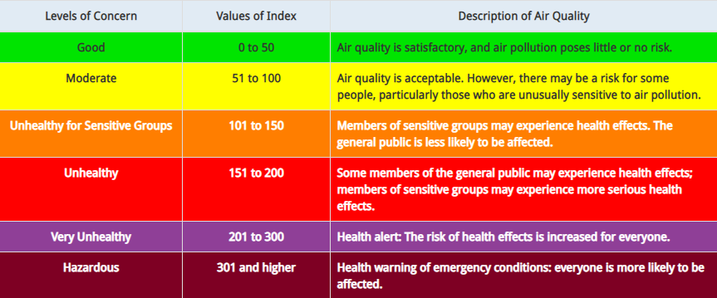
Introduction
Air pollution is defined as the presence of compounds in the atmosphere that are harmful to human beings and other living organisms
Has severe effects on human health - Respiratory issues, lungs and heart problems
Offering a holistic approach to tackle the issue of air pollution by building a device that can monitor air pollution, predict future levels of pollution and also suggest precautionary actions and methods to reduce air pollution

Slide 4
Motivation
Air pollution claims 7 million lives a year making it the most dangerous type of pollution
No present technology that is implemented on a large scale in urban areas
Lack of effective mobile apps
Lack of awareness
Demonstrate the possibility of a device to tackle to this problem which is:
  Cost effective
  Compact
  Easy to use
Help Bengaluru remain the Garden City of India for many years to come

Slide 5
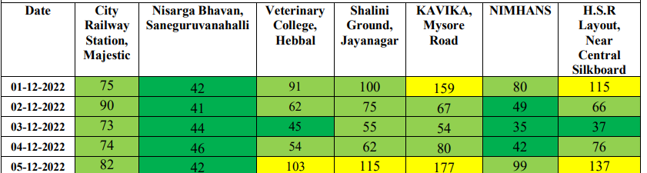
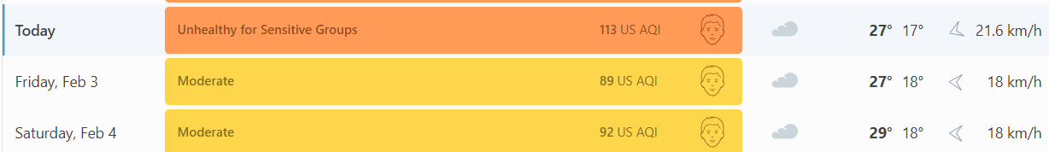
Existing System
There is no one stop solution for eliminating air pollution. With the rising trends of population expansion, urbanisation, industrialization, and increased affluence, the number of potential sources of air pollution grows quickly every year.
The only way people can get accurate updates on air pollution is by reading the Government report at the end of each month. This gives a day by day AQI breakdown for 7 major areas in Bangalore.
Another option is going by existing websites; but these only predict AQI of Bangalore as whole, which as can be seen from the above example, may not be very accurate. For example, www.iqair.com.

Slide 6
Literature Survey
SL.NO | Title of the Paper with Year | Problem Addressed | Authors Approach / Method | Results
1 | “Air pollution monitoring and prediction using IoT” | Air Pollution monitoring and predictions using IoT and sensors | The system employs IoT in conjunction with the machine learning method known as Recurrent Neural Network, specifically Long Short Term Memory (LSTM), to focus on monitoring air contaminants . | For predicting the LSTM is implemented. It has a quick convergence and reduces the training cycles with a good accuracy.
2 | “Air Pollution Monitoring and Prediction Using IoT and Machine Learning” | Air pollution monitoring and forecasting using IoT and ML | They put out a system that employs a number of sensors to measure the concentration of pollutants, and they created a number of ML models to project future pollution levels. | The stacking ensemble model had the highest accuracy and lowest error rate of all the implemented ML models.
3 | “Air Quality Monitoring And Prediction Using IOT And Machine Learning Approaches” | Air Quality Monitoring And Prediction Using IOT And Machine Learning Approaches | In this study, arduino-based sensors were used to create an air quality monitoring system that could record parameters of the air quality before the sensors were calibrated to increase accuracy. | The overall accuracy of the device according to testing was 91%. It demonstrates an increase in accuracy of between 6% to 11%, demonstrating the beneficial effects of the study's calibration processes.

Slide 7
SL.NO | Title of the Paper with Year | Problem Addressed | Authors Approach / Method | Results
4 | “Air Quality Prediction using Machine Learning Algorithms” | Air Quality predictions using various Machine Learning Algorithms | Dataset from Kaggle and models used are AutoRegressive model and ARIMA | Predicted the AQI of Maharashtra with an MSE of 166.358
5 | “Adaptive machine learning strategies for network calibration of IoT smart air quality monitoring devices” | Overcoming the limited accuracy of long term field deployment of AQMS. | They have obtained results from different calibration update scenarios to overcome drift effects arising due to multi seasonal deployment of low cost AQMS | Results indicate the relevance of both update periods and amount of labelled samples in determining the final performances. Daily updates using a single hour of high accuracy data.
6 | “Air Quality Prediction: Big Data and Machine Learning Approaches” | Big Data and Machine Learning Approaches for Predicting Air Quality | This research paper's objective is to examine various big-data and machine learning-based strategies for forecasting air quality. It has also contrasted big data-based models with already published research articles. | The development of IoT infrastructures, big data technologies, and machine learning techniques has made it desirable for future smart cities to have real-time air quality monitoring and evaluation.

Slide 8
SL.NO | Title of the Paper with Year | Problem Addressed | Authors Approach / Method | Results
7 | “Real Time Localized Air Quality Monitoring and Prediction Through Mobile and Fixed IoT Sensing Network” | Using mobile and static IoT sensors as well as ML algorithms, air quality is monitored and predicted. | This study combines both stationary and mobile IoT sensors that are mounted on vehicles that patrol the area to predict the pattern of air quality in that area. With this method, the complete range of how air quality varies in close-by areas may be examined. | Gradient Boosting Regressor gave the least RMSE for P.M2.5
8 | “IoT enabled Environmental Air Pollution Monitoring and Rerouting system using Machine learning algorithms” | Air pollution monitoring system used as a rerouting system to find pollution free route | With the collected time series samples, the prediction analysis was done with neural network Multilayer perceptron and support vector machine regression (SVMR) learning algorithm. | The Google Maps API correctly updated the pollution levels, and the advised route was the one with the lowest levels of pollution based on those levels.
9 | “Air pollution prediction through internet of things technology and big data analytics” | Using big data analytics and the internet of things, anticipate air pollution | In the context of forecasting air pollution that results from the introduction of dangerous compounds, such as NO2, SO2, CO, and O3, into the Earth's atmosphere, we explore the potential for a fusion between the two new ideas big data and internet of things in this research. | With the use of the US pollution dataset and the Databricks platform's Spark technology, it was able to create a precise model that is capable of producing reliable forecasts for air quality.

Slide 9
SL.NO | Title of the Paper with Year | Problem Addressed | Authors Approach / Method | Results
10 | “Developing a risk-based air quality health index” | Finding out the different pollutants in the air and analysing how the affect the Air Quality and consequently the health of people | Time series studies were performed to obtain the relative risks of hospital admissions for respiratory and cardiovascular diseases associated with four air pollutants: sulphur dioxide, nitrogen dioxide, ozone, and particulate matter with an aerodynamic diameter less than 10 mm (PM10). | All four air pollutants (NO2, O3, PM10 and SO2) had significantly raised RRs of emergency hospital admissions for respiratory and cardiovascular diseases for all age groups combined.
11 | “Air pollution monitoring system using IoT and Artificial Intelligence”. | Air pollution monitoring system using IoT and AI. | In this paper, they have proposed a system which monitors CO2, dust and methane. They have used a IoT device to capture the concentration of these gases in the atmosphere. | They successfully implemented the system and were able to detect the concentration of the various gases in the atmosphere. If a particular gas concentration was greater than the set threshold, an alarm was triggered.
12 | “Modelling air quality prediction using a deep learning approach: Method optimization and evaluation” | Deep learning-based modelling of air quality prediction: method improvement and assessment | In this paper , a deep learning framework to predict air quality in the following 24hrs is proposed. A neural network with a temporal sliding long short-term memory extended model (TS-LSTM) | The proposed model had better stability and performances with high correlation coefficient R Squared, compared to the multiple linear regression, support vector, the traditional LSTM, and the LSTME

Slide 10
SL.NO | Title of the Paper with Year | Problem Addressed | Authors Approach / Method | Results
13 | “Impact of lockdown on air quality in India during COVID-19 pandemic” | Analysing the Air Quality during lockdown to find out the main contributors to pollution and what caused its reduction | The trajectory analysis was performed using HYPSPLIT model. an analysis of air quality (particulate matter-PM2.5, Air Quality Index, and tropospheric NO2) over India using ground and satellite observations. | The key takeaways from the paper were the correlation between PM2.5 and AQI and how Vehicular Motion is one of the major contributors of Air Quality being poor.
14 | “A Review on Indoor Air Quality Monitoring using IoT at Campus Environment” | Analysis on various indoor air quality measuring systems | Best way to build a low cost IAQMS is by using Arduino. Pollutants most commonly are used in observations are temperature, humidity, and CO2. Next challenges from IAQ monitoring system is to improve the accuracy of sensor with the condition of ‘< 1ppm’ | This study was conducted for facilitating researchers to create a monitoring system for the Indoor Air Quality by using the Internet of Things
15 | “Air Quality Monitoring System Based on IoT using Raspberry Pi” | IoT-Based Air Quality Monitoring System Using Raspberry Pi | An independent real-time air quality monitoring system is presented in this paper. A cutting-edge method for better managing data from various sensors may be found in the Internet of Things and cloud computing.. | A cutting-edge method for improved data management is provided by the Internet of Things and cloud computing. Data from various sensors is collected and transferred by the low-cost, ARM-based Raspberry Pi minicomputer.

Slide 11
SL.NO | Title of the Paper with Year | Problem Addressed | Authors Approach / Method | Results
16 | “Air Quality Index Forecasting using Auto-regression Models” | To forecast the AQI while taking into consideration external factors such as Wind speed, Atmospheric Pressure, Mean temperature, etc. | The ARIMA model is employed. Detrending, differencing, and other techniques can be used to change a non-stationary series into a stationary series. | The MSE was 27.00 when auto-regression was used on a time series dataset to forecast the Air Quality Index value seven days in advance.
17 | “Forecasting of Daily Air Quality Index in Delhi” | To forecast the Daily Air Quality index in Delhi to improve the decision making process of the Government and help people take necessary measures. | 3 different models were built; ARIMA, PCR (a combination of PCA and MLR), and a combination of the aforesaid 2 models. | The 3rd model; a combination of PCR and ARIMA, seemed to understand the underlying correlations and patterns between the data points to give the best results.
18 | “Daily Air Quality Index forecasting with hybrid models: A Case in China” | To build better and more accurate models than the currently existing models such as ARIMA, multiple linear models and SVR. | Two hybrid models(EMD-SVR-Hybrid and EMD-IMFs-Hybrid) are proposed. | The results of these hybrid models are better than ARIMA, SVR and other models such as EMD-GRNN, GRNN, etc.

Slide 12
Survey Summary
[1-6]The papers we have surveyed have shown us different approaches of building an IOT device to measure the various pollutants in the atmosphere. We got an idea of the most damaging pollutants and the formula to calculate the AQI. A few papers have built and used the IoT device to capture the concentration of pollutants and then used ML Algorithms to predict the AQI. In these papers we were introduced to forecasting and predicting techniques such as ARIMA, Support Vector Regression, LSTM, etc. We also got a rough outline of building the IoT devices.
Paper [7] introduced us to using multiple sensors (Fixed and Mobile) to improve accuracy while paper [8] spoke about rerouting traffic based on it. Paper [9] discussed using Big Data. Paper [12] introduced using Deep Learning for forecasting, that is; to use Temporal Sliding along with LSTM.
Paper [13] discussed the impact of Covid19 induced lockdown on the Air Quality and this gave us an insight about how a lot of pollution is caused by traffic. Paper [14] discussed modelling an Air Pollution system for an indoor environment (a campus), and [15] spoke about building an IoT device using Raspberry Pi.
[16] detailed on ARIMA model and introduced using other features such as wind speed, temperature, humidity, wind direction, etc. Paper [17] gave an insight on on combining PCA and ARIMA for modelling the Time Series. Paper [18] discussed using EMD-SVR and EMD-IMF hybrid models.

Slide 13
Proposed System
We propose to build an IoT device using Arduino Uno and several sensors to detect pollutants such as Particulate Matter, Nitrogen Oxides, Sulphur Dioxide, Ozone, Carbon Monoxide, etc. Using hourly values of these sensors, we will calculate the sub indices of each pollutant and hence the AQI. AQI will be calculated per day.
Using the collected AQI data, and existing dataset from 2015 to 2020, and 2021-2022, we aim to build a Machine Learning model to forecast the AQI for the coming few days in Jayanagar-Basavanagudi region.
Why only this region? Because the AQI at any given time varies all over Bangalore. Hence, if we can model one area accurately, repeating the same for all other areas should be easy.
We aim to build a website showing daily forecasts of AQI, giving tips on reducing the AQI and precautionary measures to help people negate the effects of pollution, especially for people suffering from respiratory and cardiovascular complications.
We are also planning to implement an automated tweeting system to push tweets on Twitter everyday once the prediction has been made, to ensure easy access of information to all residents.

Slide 14
Applications
Protecting the environment, ecosystem and biodiversity of the planet
Protecting the environment, ecosystem and biodiversity of the planet
Industrial compliance and regulations
Integration with Google Maps
Policy making
City planning
Research
Education and awareness

Slide 15
SYSTEM REQUIREMENT SPECIFICATION
Functional Requirements
Connectivity: Ability of the system to connect and communicate with various sensors, devices and networks
Data collection and storage: Ability of the system to collect data from various sensors, store it and upload it the cloud storage
Integration: Ability to integrate the system with other systems like database and cloud offerings
Alerts and Notifications: Ability to issue the appropriate notifications and alerts for specific conditions.
Ability to analyse the collected data and perform accurate prediction in real time.

Slide 16
Non-functional Requirements
Accuracy: Accuracy is predictions and issuing alerts and notifications should be greater than 97%
Reliability: Ability to ensure consistent and accurate data collection, data analysis and predictions
Usability: Ability to provide an extremely interactive and user friendly interface so that the users can have a good experience using our system
Cost Effectiveness: We want to provide a cost effective solution which is economic and affordable.
Robustness: Ability to work with noisy and corrupted data and filter them out.
Scalability: Ability to handle the enormous amount of data and processing, and also to allow the implementation of more number of devices
Supportability: Ability to perform updates and modifications with ease

Slide 17
Hardware Requirements
Arduino Uno
Breadboard
WiFi module
Jumper Wires
Comparator
Adjustable potentiometer
Resistor set
Capacitors
Computer/laptop with internet connection
MQ131 Ozone sensor
MQ135 Air Quality sensor
PM 2.5 Particle sensor
MQ7 CO sensor
DHT11 sensor
110-602 SO2 Sensor
mics-6814
Software Requirements
IDEs such as Visual Studio Code, Google Colab and Arduino IDE
Python and libraries like NumPy, Pandas, Tensorflow
ThingSpeak
Cloud database such as Firebase

Slide 18
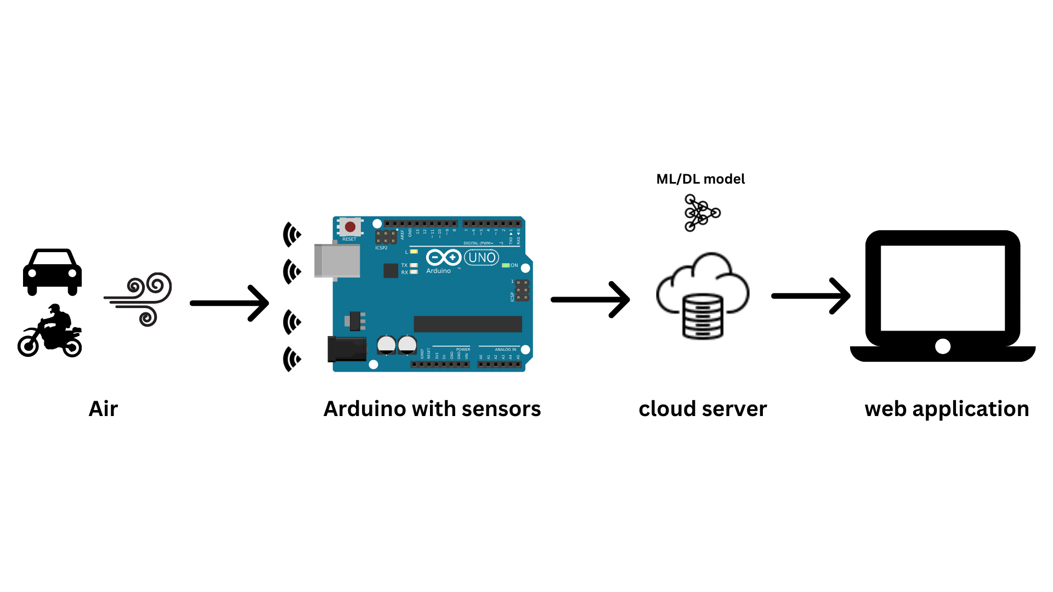
SYSTEM DESIGN
System Architecture

Slide 19
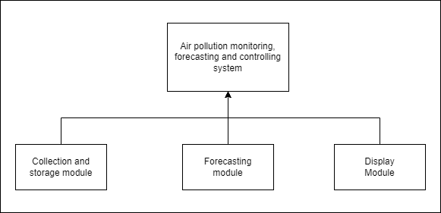
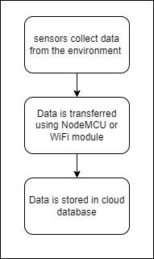
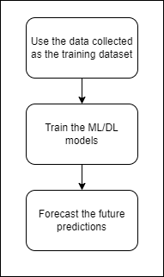
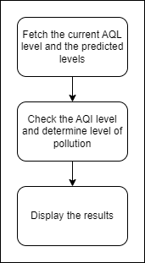
Module Design

Slide 20
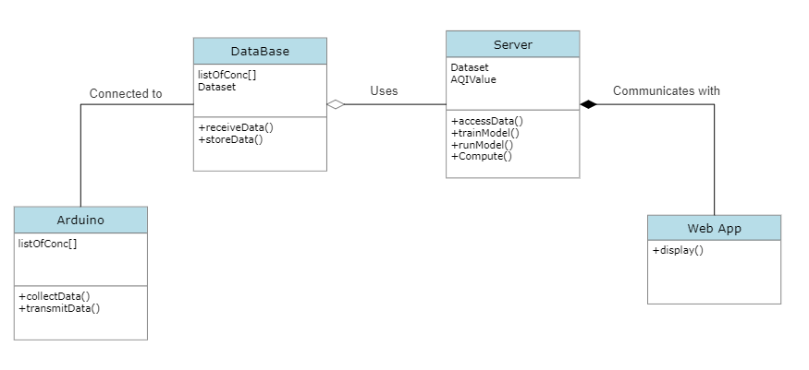
DETAILED DESIGN
Class Diagram

Slide 21
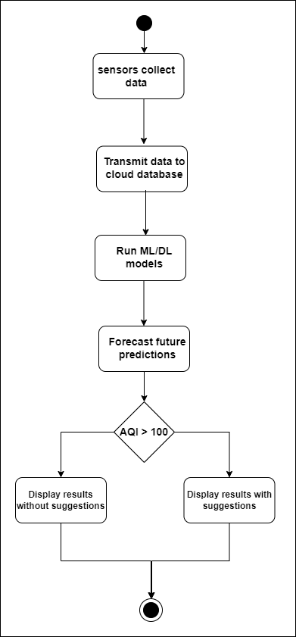
Activity Diagram

Slide 22
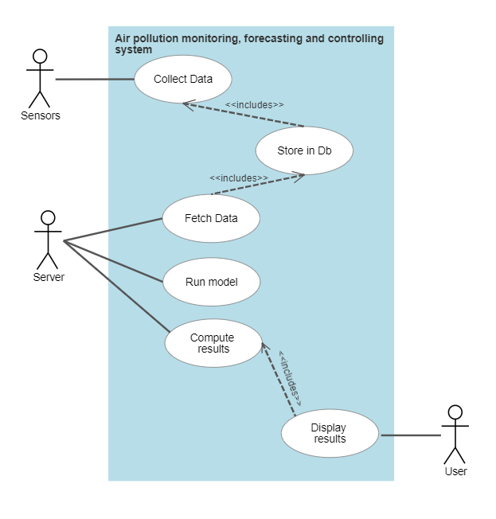
Use Case Diagram

Slide 23
References
[1] Temesegan Walelign Ayele, et. al “Air pollution monitoring and prediction using IoT'', Inventive Communication and Computational Technologies, 2018.
[2] Ssneha Balasubramanian et al. “Air Pollution Monitoring and Prediction Using IoT and Machine Learning”, IJCSIT, 2021.
[3] T.S. Kitchilan, M.D.B.C.K. Abeyratne et al. “Air Quality Monitoring And Prediction Using IOT And Machine Learning Approaches”, IJSRP, 2022.
[4] Sachin Bhimrao Bhoite et al. “Air Quality Prediction using Machine Learning Algorithms”, International Journal of Computer Applications Technology and Research, 2019.
[5] Saverio De Vito, et al. “Adaptive machine learning strategies for network calibration of IoT smart air quality monitoring devices”, Pattern Recognition Letters, 2020.
[6] Gaganjot Kaur, et. al “Air Quality Prediction: Big Data and Machine Learning Approaches”, International Journal of Environmental Science and Development, 2018.

Slide 24
References
[7] Dan Zhang, et al. “Real Time Localized Air Quality Monitoring and Prediction Through Mobile and Fixed IoT Sensing Network”, IEEE Access, 2020.
[8] Leeban Moses, et al. “IoT enabled Environmental Air Pollution Monitoring and Rerouting system using Machine learning algorithms”, IOP Conference Series, 2020.
[9] Safae Sossi Alaoui et al, “Air pollution prediction through internet of things technology and big data analytics” ,International Journal of Computational Intelligence Studies, 2019.
[10] Tze Wai Wong, et al. “Developing a risk-based air quality health index”, Elesevire, 2012.
[11] Meivel S, et. al “Air pollution monitoring system using IoT and Artificial Intelligence”, International Journal of Modern Agriculture, 2021.
[12] Wenjing Mao, Weilin Wang, Limin Jiao, Suli Zhao, Anbao Liu, “Modeling air quality prediction using a deep learning approach: Method optimization and evaluation”, Elsevier, 2020.

Slide 25
References
[13] Ramesh P. Singh, et al. “Impact of lockdown on air quality in India during COVID-19 pandemic”, Springer Nature B.V., 2020.
[14] Anindya Ananda Hapsari, et al. “A Review on Indoor Air Quality Monitoring using IoT at Campus Environment”, International Journal of Engineering and Technology, 2018.
[15] Somansh Kumar, “Air Quality Monitoring System Based on IoT using Raspberry Pi”, IEEE, 2017.
[16] Nimisha Tomar, et al., “Air Quality Index Forecasting using Auto-regression Models”, IEEE, 2020.
[17] Anikendar Kumar, et al.“Forecasting of daily Air Quality Index in Delhi”, Elsevier, 2012.
[18] Suling Zhu, et al., “Daily Air Quality Index forecasting with hybrid models: A Case in China”, Elsevier, 2017.

Slide 26

12

Slide 27

13

